Slide 1
CPA&GPA Calculator
C++
BY: Syahmi Hanis
Wan Nuraina Anisah
Shazwani Farzana

Slide 2
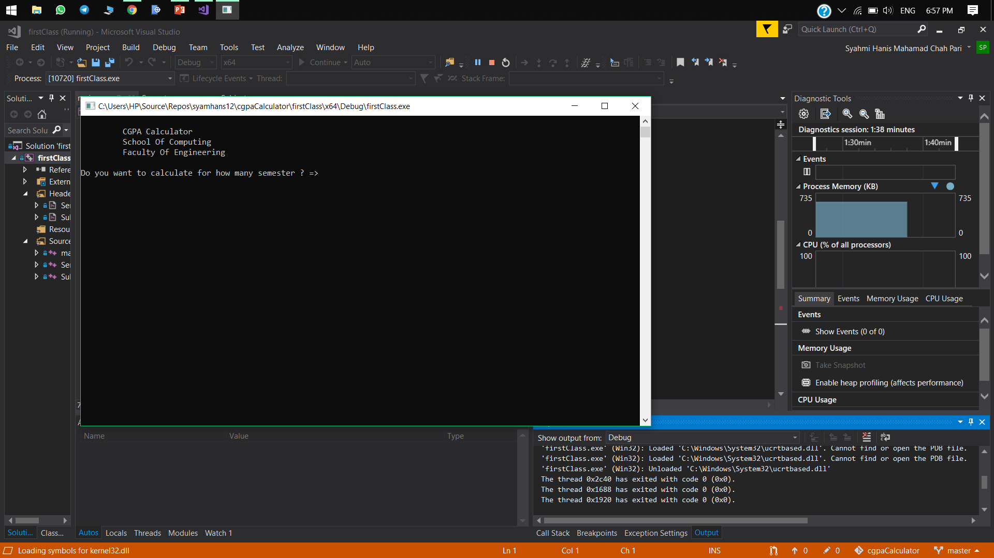
The students required to enter the total of semester they want to calculate.

Slide 3
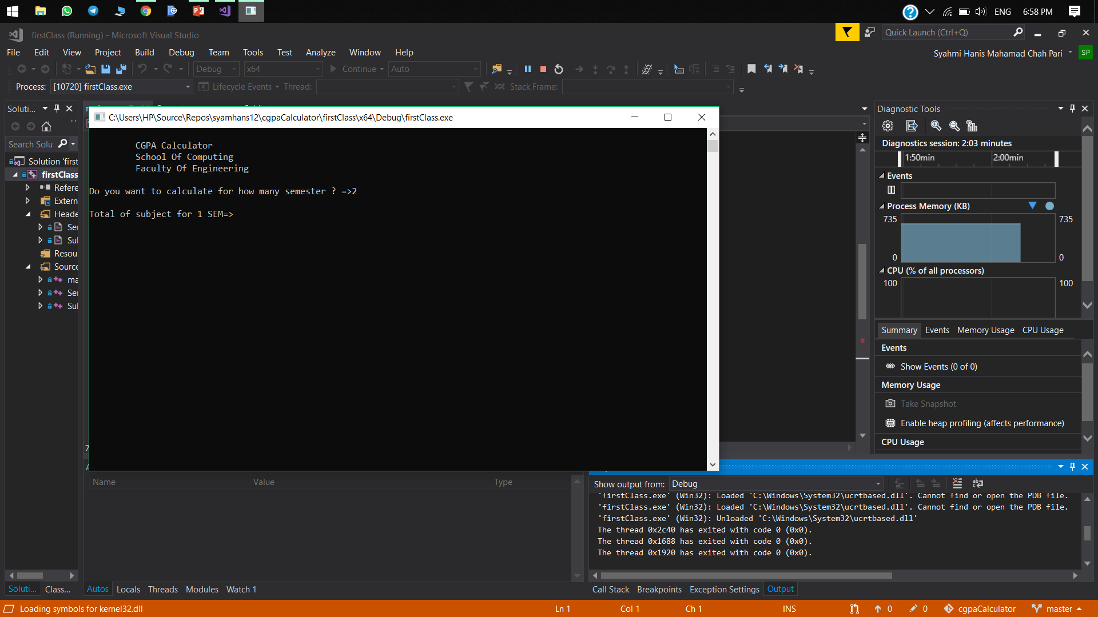
The students required to enter the number of subject for the first semester.

Slide 4
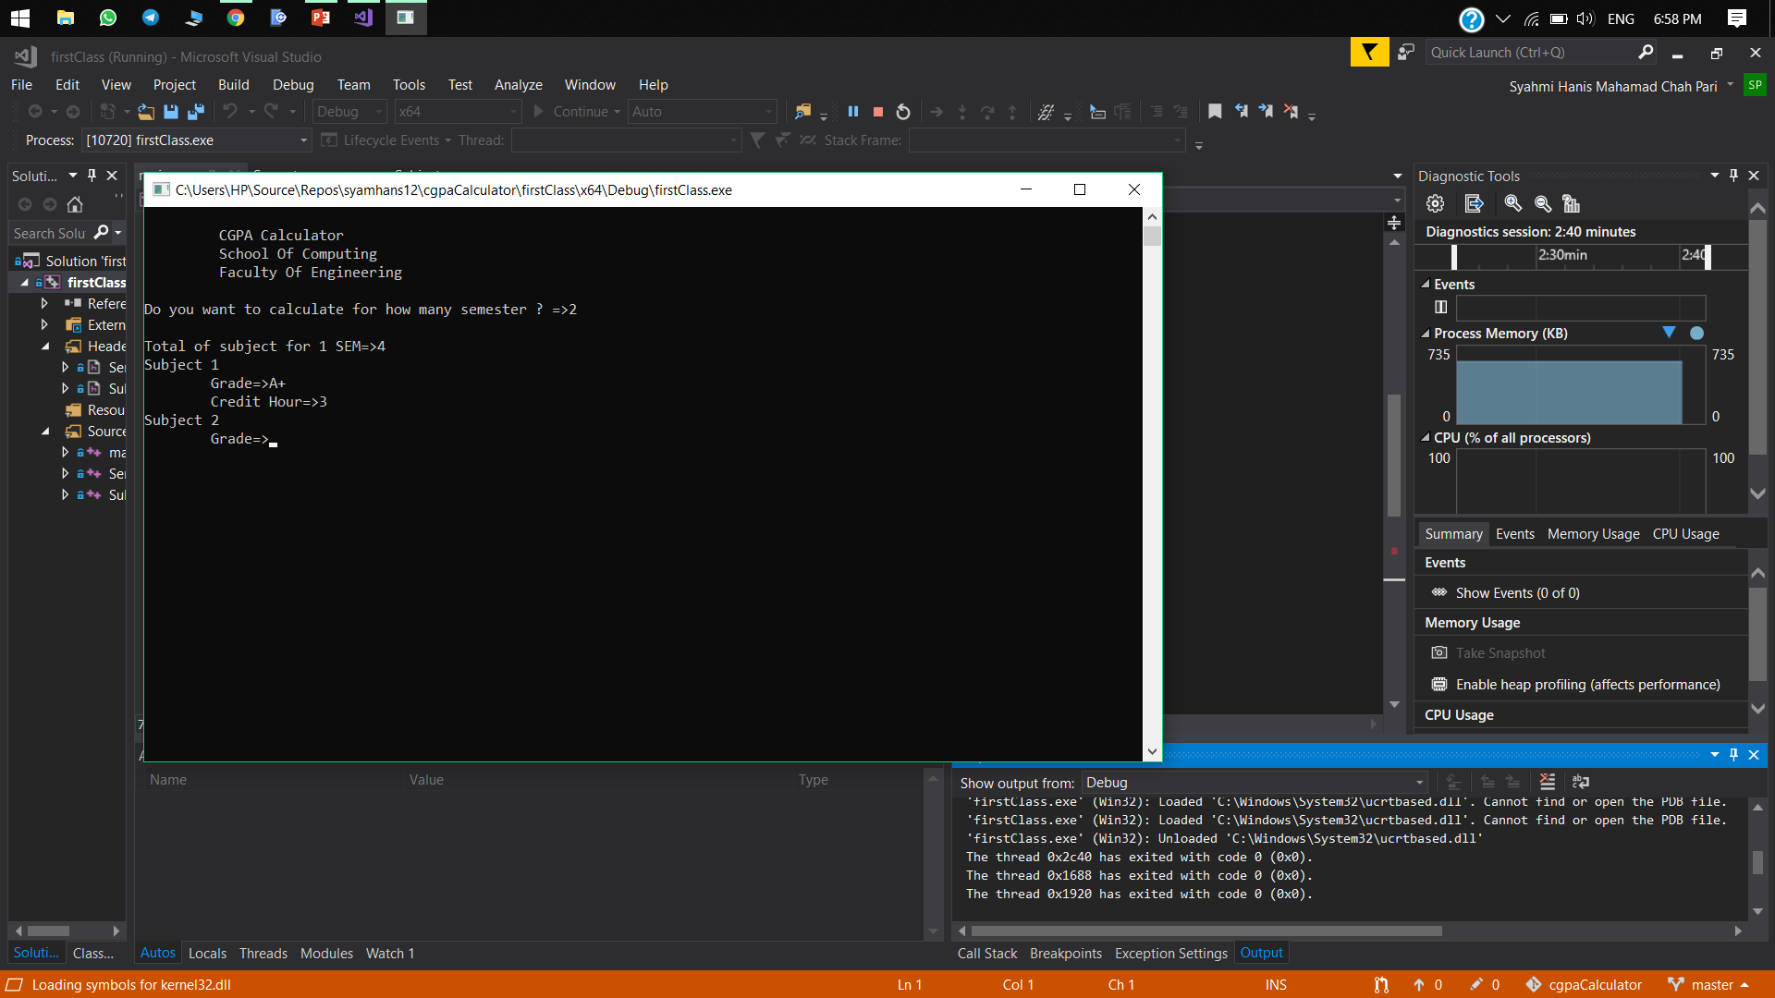
Enter the valid grade, such as A+,A-,B,C- and etc.
Then enter the credit hour.

Slide 5
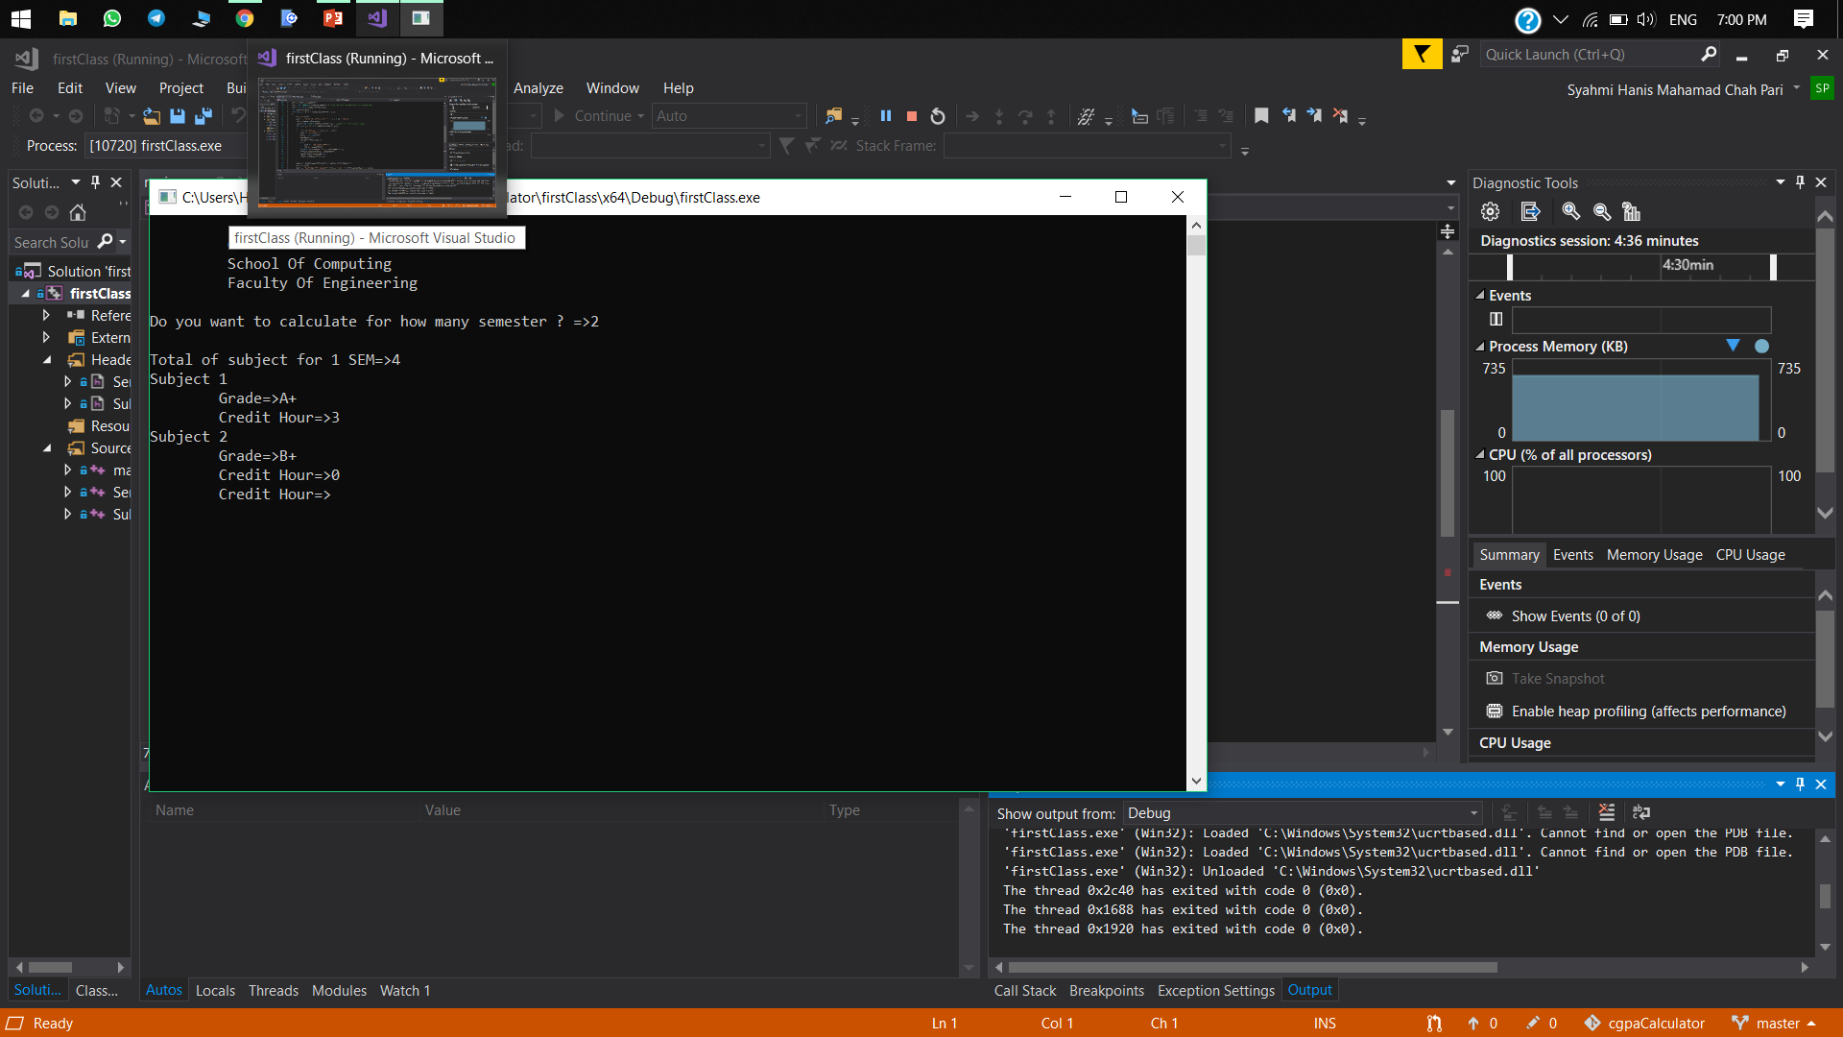
The program will only accept 1 until 4 credit hour. The program will not ask for valid credit hout until the user enter the correct required input.

Slide 6
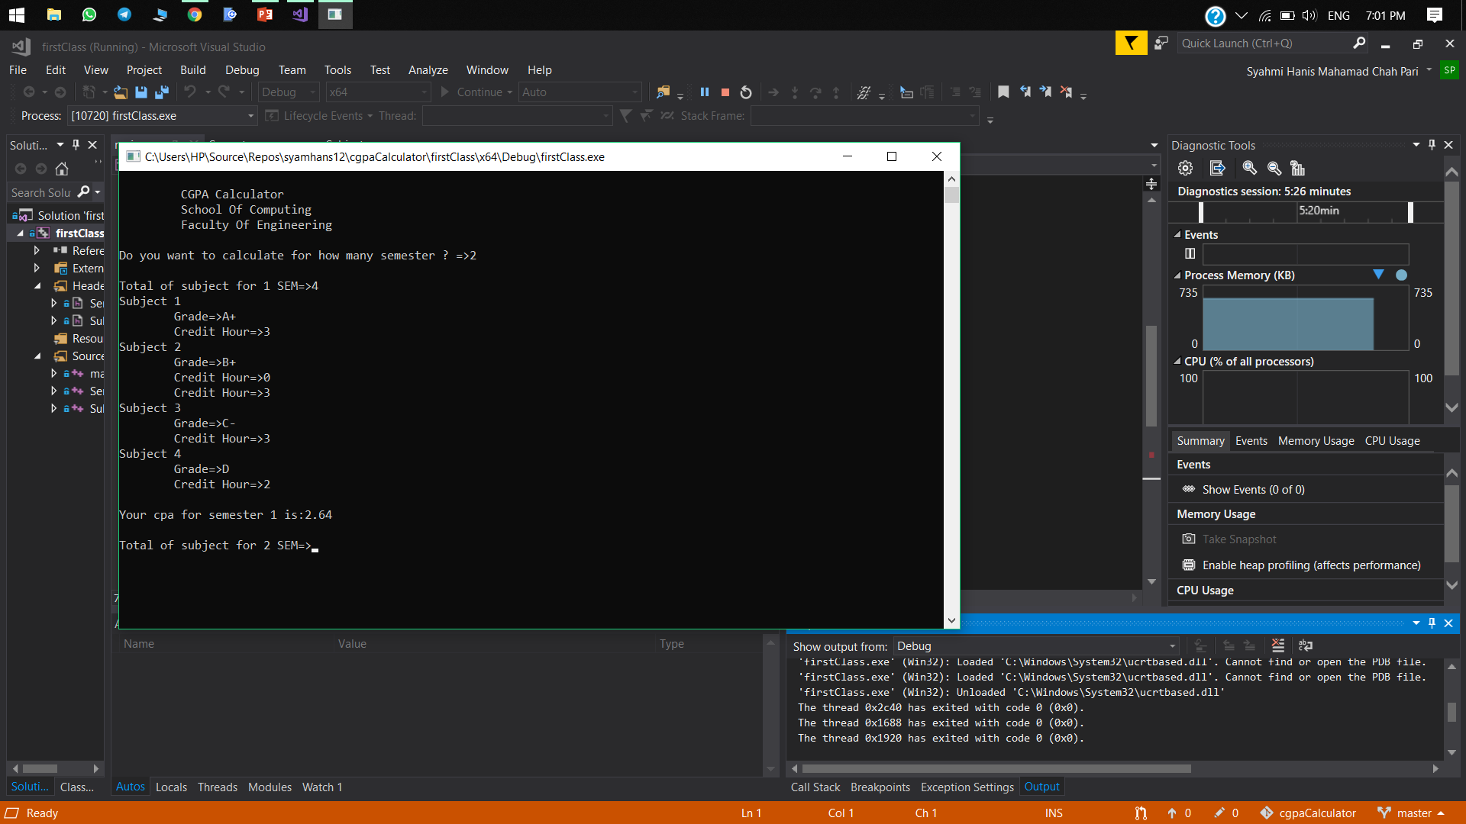
Users will get the cpa of their first semester.

Slide 7
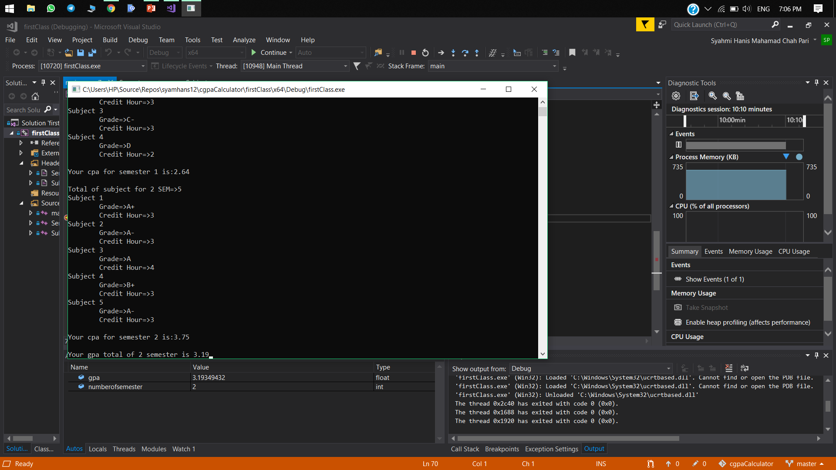
Repeat the same step as before for next semester. Once the program calculate all the cpa for the total of semester entered by the user, it will display the final gpa.

